Slide 1
Keyword Spotting – a neural network approach
Final project: machine Audition and perception
Presented by: Venkatesh Raizaday

Slide 2
Index
What is Keyword Spotting
Why keyword spotting
Approach (Deep nets and recurrent neural networks)
Experiments (Data, Preprocessing, tensor flow)
Results
Difficulties and Future Work

Slide 3
Keyword spotting
The process of recognizing specific keywords in continuous speech.
Usually there are 3 types of methods employed to achieve this task:
- LVCSR based KWS
- Acoustic KWS
- Phonetic Search KWS
I have tried to employ Acoustic KWS scheme.

Slide 4
Why keyword spotting
Multiple devices in everyday world that are speech driven.
Large LVCSR systems in each device not possible/practical.
Most tasks can be done by recognizing few keywords rather than translating whole sentences. (Eg: What is the weather, what meetings do I have today)
Can easily be framed as a classification problem.
Neural networks once trained are very efficient/fast. Best for low power consumption on mobile devices.
Provides a framework to makes thing work offline as well.

Slide 5
Deep neural networks
Originated from the perceptron model with basic idea of trying to mimic human brain behavior/ neurons.
Neural networks with more than 1 hidden layer are known as deep neural networks.
Recently have seen a surge in usage due to exceptional performance in many tasks (Image net, LVCSR etc.)

Slide 6
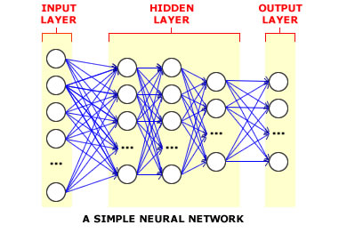
Deep neural networks

Slide 7
Deep neural networks
Neuron: Each layer has multiple neurons whose output is based on an activation function.
Weights: Neurons in each layer are connected to the neurons of subsequent layer through a link having a specific weight. This weight is adjusted during the training process to reduce the error rate/cost and improve the performance.
Input Layer: The data is passed through this layer initially. There is only one input layer.
Hidden Layer: The number of hidden layers can vary based on the complexity of the problem. For our case we are using 3 layers.
Output Layer: The neurons in the output layer are usually equal to the number of classes in our classification problem.

Slide 8
Deep neural networks
Back Propagation Algorithm: The key to the end of neural network winter. This algorithm allows us to adjust the weights of various links by combining this method with an optimization method such as stochastic gradient descent.
This is two phase method. First output is calculated for a training instance then cost/loss is calculated using a function.
Second, using the loss function gradient is calculated with respect to the weights in the network and then the calculated gradient is fed to the optimization method, which in turn uses it to update the weights, in an attempt to minimize the loss function.

Slide 9
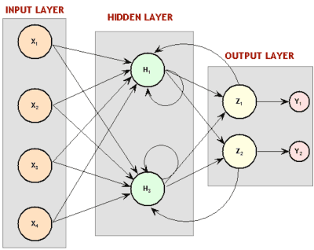
Recurrent neural networks

Slide 10
Recurrent neural networks
Most neural networks are feed forward that is there is no dependency of previous states on the current state.
Language models, self driving cars etc. are examples where past information can be used to make better predictions.
This is precisely what an RNN is used for.
RNNs do not have to be organized in layers and directed cycles are allowed. In fact, neurons are actually allowed to be connected to themselves.
This brings a concept of time to our neural network.

Slide 11
Recurrent neural networks
KWS can also benefit from the use of RNN as a single word is distributed across multiple stft bins.
Knowledge of information in previous bins can prove to be helpful in recognizing a word.
We use a Long Short Term Memory cell in our RNN.

Slide 12
Long short term memory cells
RNN’s perform well when dependencies are close by but when dependencies are far away our basic RNN might fail.
LSTMs are explicitly designed to avoid the long-term dependency problem. Remembering information for long periods of time is practically their default behavior, not something they struggle to learn.
LSTMs have something called gates which optionally have a choice to let information through.
The gates control the flow of information in and out of the cell memory.

Slide 13
Why neural networks
Most approaches use HMM to generate an underlying model/dictionary and then use Viterbi algorithm to calculate the probability of a given utterance being the word.
More and more research is moving towards neural networks for this approach due to the advent of RNN’s and more complex methods.
Moreover, I tried to implement a HMM based KWS method and the results were drastically low.

Slide 14
Experiment – Data
The data used is taken from the CSTR VCTK Corpus - English Multi-speaker Corpus for CSTR Voice Cloning Toolkit.
High frequency words were chosen from the dataset.
FrequencyCalculator.py has the code for generating frequencies.
Finally the chosen words were: 'people', 'rainbow', 'time', 'should', 'decision', 'home', 'scotland', 'things‘
The first four words have double the frequency when compared to the latter which in the later experiments will help us to see what change amount of data has on accuracy.

Slide 15
Experiment – preprocessing
Spectrograms of each wav file was created for input.
The size of each vector is 257 * XXXX where the latter value depends upon the length of the clip.

Slide 16
Experiment – Tensor flow
Tensor flow is a google open source library for numerical computation using data flow graphs.
It provides an extensive toolkit to work with deep learning and its variants.
Tensor flow has both DNN and RNN libraries where one can design their network and train / test it with their data.
Although it was created by Google brain team exclusively for machine learning and deep learning research, the framework is generic enough to accomplish variety of tasks.

Slide 17
Experiment – network specifics (DNN)
Input Layer: 257 neurons
Hidden Layers : 3, 500 neurons each
Output Layer: 4 neurons
Activation Function: Rectified Linear Unit (ReLU)
Optimization Function: Adam Optimizer (Variant of stochastic gradient descent)

Slide 18
Experiment – network specifics (RNN)
512 LSTM cell RNN
257 cells for input.
4 for output
The framework sets the remaining structure using MultiRNNCell class
Optimizer: Adam Optimizer
*** Tensor flow provides a very black box implementation of RNN where input cells and output cells are based of your input and expected output. You just initialize the total number of LSTM cells.

Slide 19
results
 | Deep Neural Network | Recurrent Neural Network
Less Data | 0.27 | 0.41
More Data | 0.29 | 0.43
Recurrent neural networks perform better than deep neural networks which shows the former are more suitable to the task
More data implies better performance. Currently the amount of data the network is trained on is very less compared to the dimensionality of the data. So better quality data can also result in better results.

Slide 20
challenges
Finding data for the problem was very difficult.
Aligning audio data to use with tensor flow framework has very few references.
The computation power required to train systems is not very scalable.
On converting audio to respective spectrograms the size increases drastically. Hence training on personal system requires batch processing.

Slide 21
Future Work
The RNN has shown promise to solve this problem so getting appropriate dataset and then running this model.
Implement a hashing based KWS method which basically is a dimensionality reduction technique of representing data.
Saving the trained neural network as training takes a lot of time.

Slide 22
questions

